Slide 1

School of Science and Humanities
Department of Physics
Physics for Engineers
Course Code : SPHA1101
Dr. M. Manjula
Assistant Professor
Department of Physics
Sathyabama Institute of Science and Technology, Chennai.

Slide 2


Slide 3
Unit 1: Basis of Quantum Physics
Syllabus
Introduction - electromagnetic waves - Photoelectric effect, Compton scattering, photons, Franck-Hertz experiment, Bohr atom, electron diffraction.
Wave - particle duality of radiation, de -Broglie waves, wave-particle duality of matter.
Physical interpretation of wave function, conditions to be satisfied for an acceptable wave function, normalized wave function, wave packets.
Heisenberg uncertainty principle - statement, applications to radius of Bohr’s first orbit and to energy of particle in 1D box. Operators associated with different observables.
Schrodinger Equation – stationary states - Eigen value, Eigen function.
Physical applications of Schrödinger’s equation to
(i) square well potential in one dimension: transmission and reflection coefficient at a barrier.
Application of barrier penetration-α decay, field-ionization and scanning tunnelling microscope

Slide 4
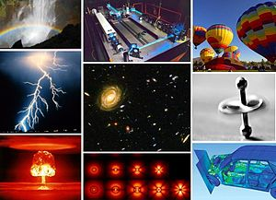
Physical Fundamentals of Mechanics
Physics – one of the fundamental natural sciences – studying the laws of inanimate nature.
Physics – Greek term meaning ‘Nature’ – science dedicated to study of all natural phenomena.
The ultimate aim of physics is to find a unified set of laws governing matter, motion, and energy at small (microscopic) subatomic distances, at the human (macroscopic) scale of everyday life, and out to the largest distances.
Goal – understand how the universe behaves.

Slide 5
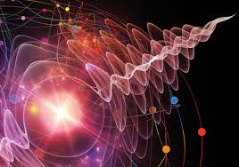
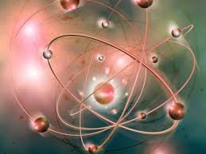
Unit -I Basis of Quantum Physics
Quantum physics governs the way the universe behaves at the scale of atoms, electrons and photons.
Quantum physicists put the rules of this quantum world to the test and devise ways to stretch their boundaries.

Slide 6
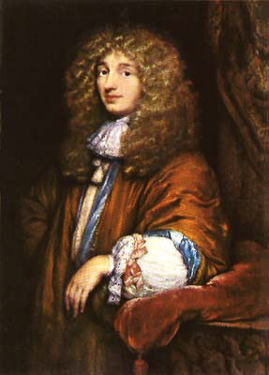
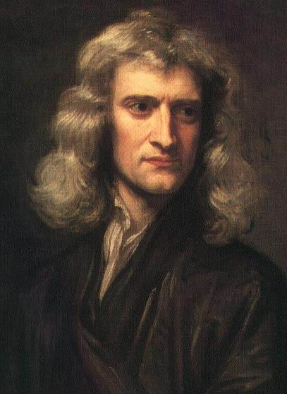
Christiaan Huygens
Dutch 1629-1695
light consists of waves
Sir Isaac Newton
1643 1727
light consists of particles

Slide 7
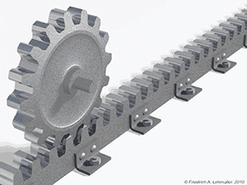
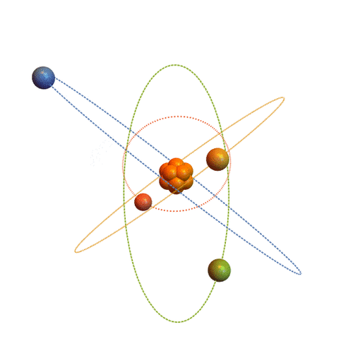

Classical Mechanics and Quantum Mechanics
Mechanics: the study of the behavior of physical bodies when subjected to forces or displacements
Classical Mechanics: describing the motion of macroscopic objects.
Macroscopic: measurable or observable by naked eyes.
Quantum Mechanics: describing behavior of systems at atomic length scales and smaller.

Slide 8
The Development of Quantum Theory
In 1900, Planck made the assumption that energy was made of individual units, or quanta.
In 1905, Albert Einstein theorized that not just the energy, but the radiation itself was quantized in the same manner.
In 1924, Louis de Broglie proposed the wave nature of electrons and suggested that all matter has wave properties. This concept is known as the de Broglie hypothesis, an example of wave–particle duality, and forms a central part of the theory of quantum mechanics.

Slide 9
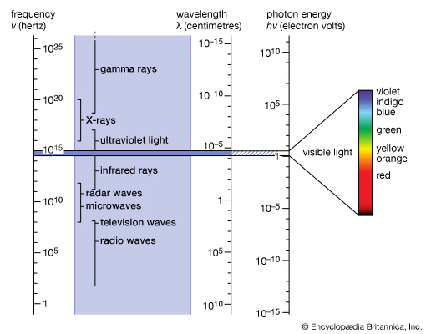
Electromagnetic Waves
Electromagnetic waves or EM waves are waves that are created as a result of vibrations between an electric field and a magnetic field. In other words, EM waves are composed of oscillating magnetic and electric fields.
Electromagnetic radiation (EM radiation or EMR) refers to the waves (or their quanta, photons) of the electromagnetic field, propagating (radiating) through space, carrying electromagnetic radiant energy.
It includes radio waves,
microwaves,
infrared,
(visible) light,
ultraviolet,
X-rays, and gamma rays

Slide 10
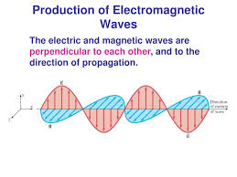
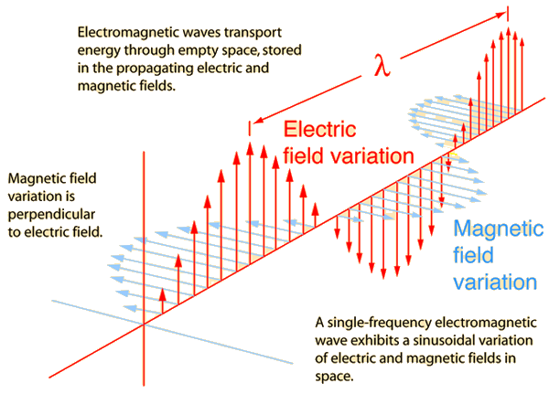
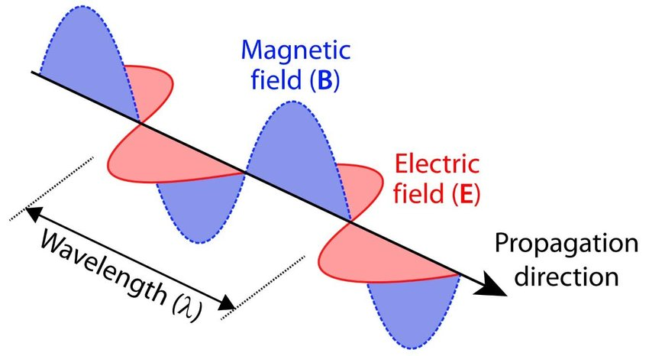

Slide 11
Description:
- Electromagnetic waves are formed when an electric field comes in contact with a magnetic field. They are hence known as ‘electromagnetic’ waves.
- The electric field and magnetic field of an electromagnetic wave are perpendicular (at right angles) to each other. They are also perpendicular to the direction of the EM wave.
- EM waves travel with a constant velocity of 3.00 x 10⁸ m/s in vacuum.
- They are deflected neither by the electric field, nor by the magnetic field. However, they are capable of showing interference or diffraction.
- An electromagnetic wave can travel through anything - be it air, a solid material or vacuum.
- It does not need a medium to propagate or travel from one place to another.
- EM waves are 'transverse' waves. This means that they are measured by their amplitude (height) and wavelength (distance between the highest/lowest points of two consecutive waves).
- The highest point of a wave is known as 'crest', whereas the lowest point is known as 'trough’.
- Electromagnetic waves can be split into a range of frequencies. This is known as the electromagnetic spectrum. Examples of EM waves are radio waves, microwaves, infrared waves, X-rays, gamma rays, etc.

Slide 12
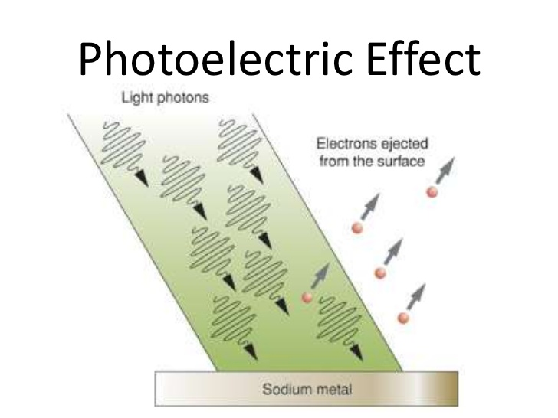
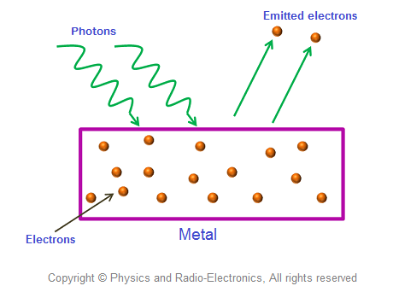
Photoelectric Effect
The process of emission of electrons from a metal plate, when illuminated by light of suitable wavelength – Photoelectric effect.
Emitted electrons – photoelectrons
Alkali metals – photoelectric emission occurs – under the action of visible light
Zinc, Cadmium, etc..- sensitive to only UV light

Slide 13
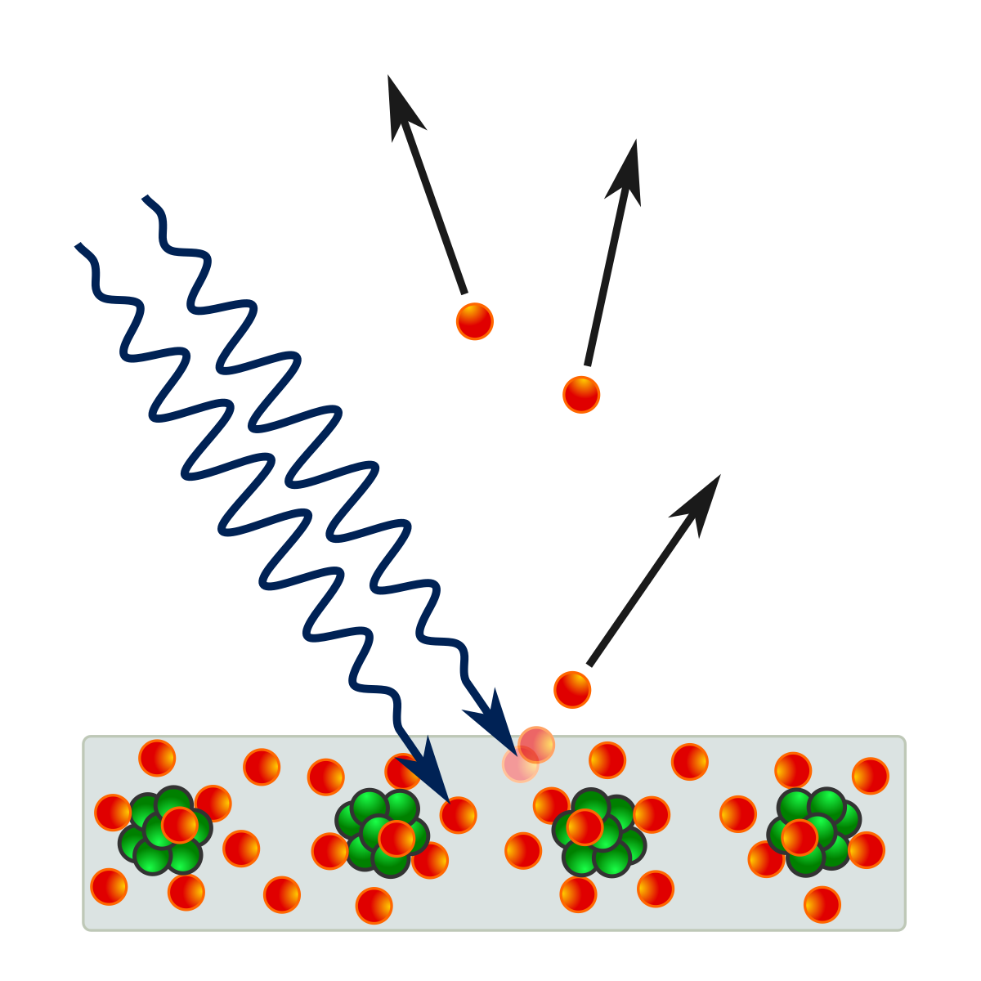
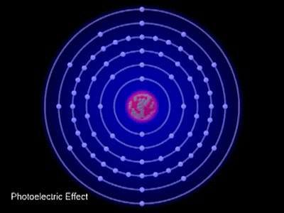
Experimental determination of photoelectric effect
Emission of electrons from a metal plate, when illuminated by light or other radiations (UV, X-rays) of suitable wavelength /frequency – photoelectric effect
Hertz – he allowed UV light to fall on zinc plate.
Experimental verification done by Hallwaches, Leonard, JJ Thomson, R.A. Millikan and others
Millikan – 1868-1953 – effect with no. of alkali metals over a wide range of frequency – Nobel prize 1923.

Slide 14
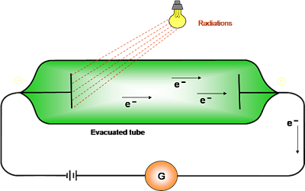
The apparatus consist of two photosensitive surfaces A and B enclosed – evacuated quartz bulb.
Plate A connected – (-ve) terminal of battery ; B – connected to +ve terminal thro G or micrometer
Absence of light – no flow of current – no deflection in G
When monochromatic light is allowed to fall on plate A – current starts flowing in the circuit – indicated by G – current is known as photo current
When light falls on metallic surface – electrons are ejected
The no. of electrons emitted and their kinetic energy depends upon the following factors:
- Potential difference between two electrodes …..between A and B
- the intensity of incident radiation
- frequency of incident radiation
- the photometal used

Slide 15
Laws of photoelectric emission
For every metal, there is a particular minimum frequency of the incident light, below there is no photoelectric emission, whatever be the intensity of the radiation. The minimum frequency, which can cause photoelectric emission is called the threshold frequency.
The number of electrons emitted per second (i.e) photoelectric current is proportional to the intensity of incident light – provided the frequency is greater than the threshold frequency.
The velocity and hence the energy of the emitted photoelectrons is independent of the intensity of light and depends only on the frequency of the incident light and the nature of the metal
Photoelectric emission is an instantaneous process. The time lag, if any between incidence of radiation and emission of the electrons, is never more than 3 x 10⁻⁹ sec.

Slide 16
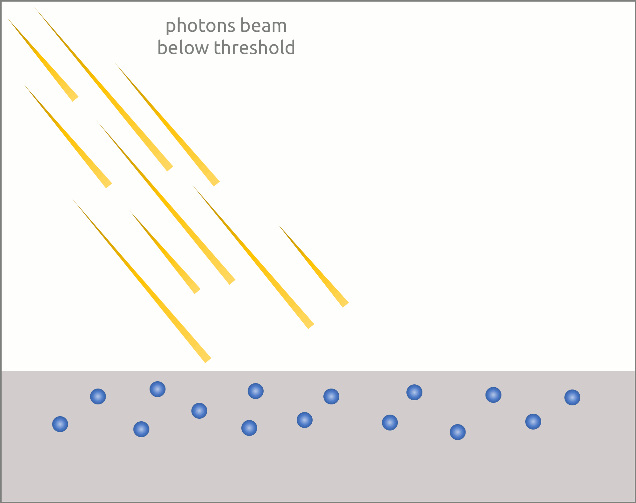
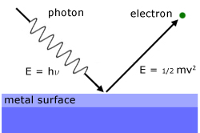
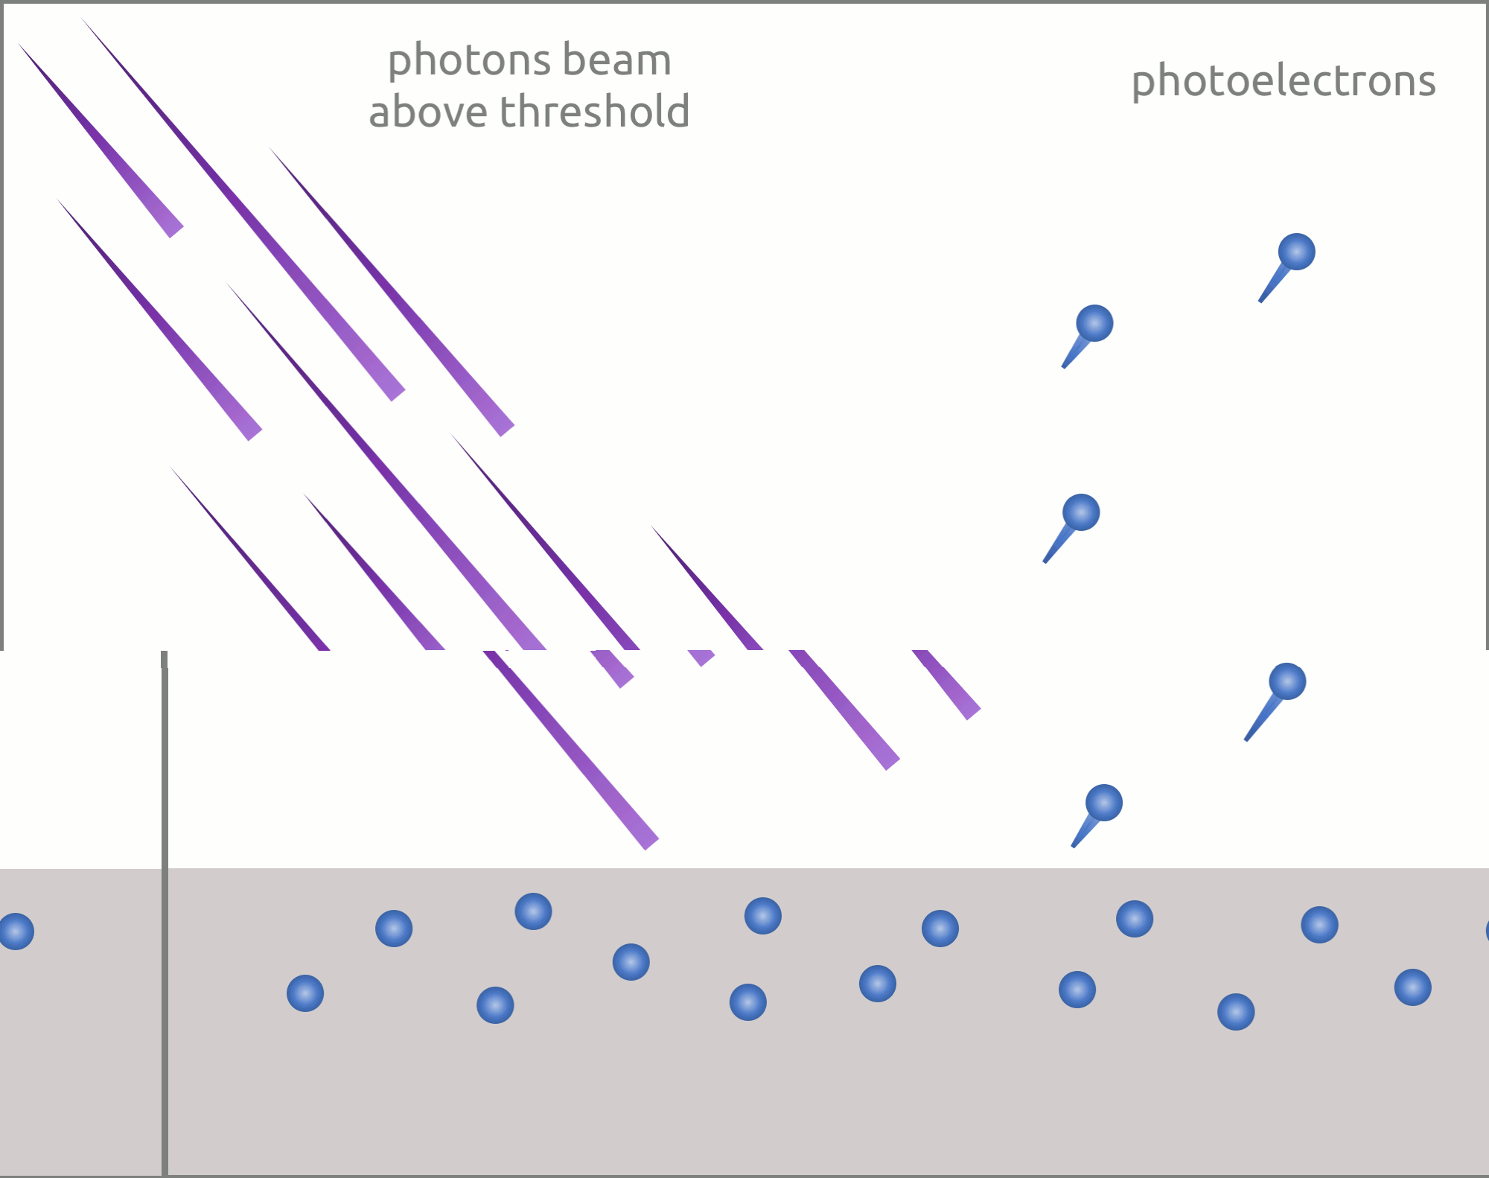
Light must have stream of energy particles or quanta of energy (hν). Suppose, the threshold frequency of light required to eject electrons from a metal is ν₀, when a photon of light of this frequency strikes a metal it imparts its entire energy (hν₀) to the electron.

Slide 17
Inconsistency with classical light theory
According to the classical wave theory, maximum kinetic energy of the photoelectron is only dependent on the incident intensity of the light, and independent on the light frequency; however, experimental results show that the kinetic energy of the photoelectron is dependent on the light frequency.
Concept of “energy quanta”

Slide 18
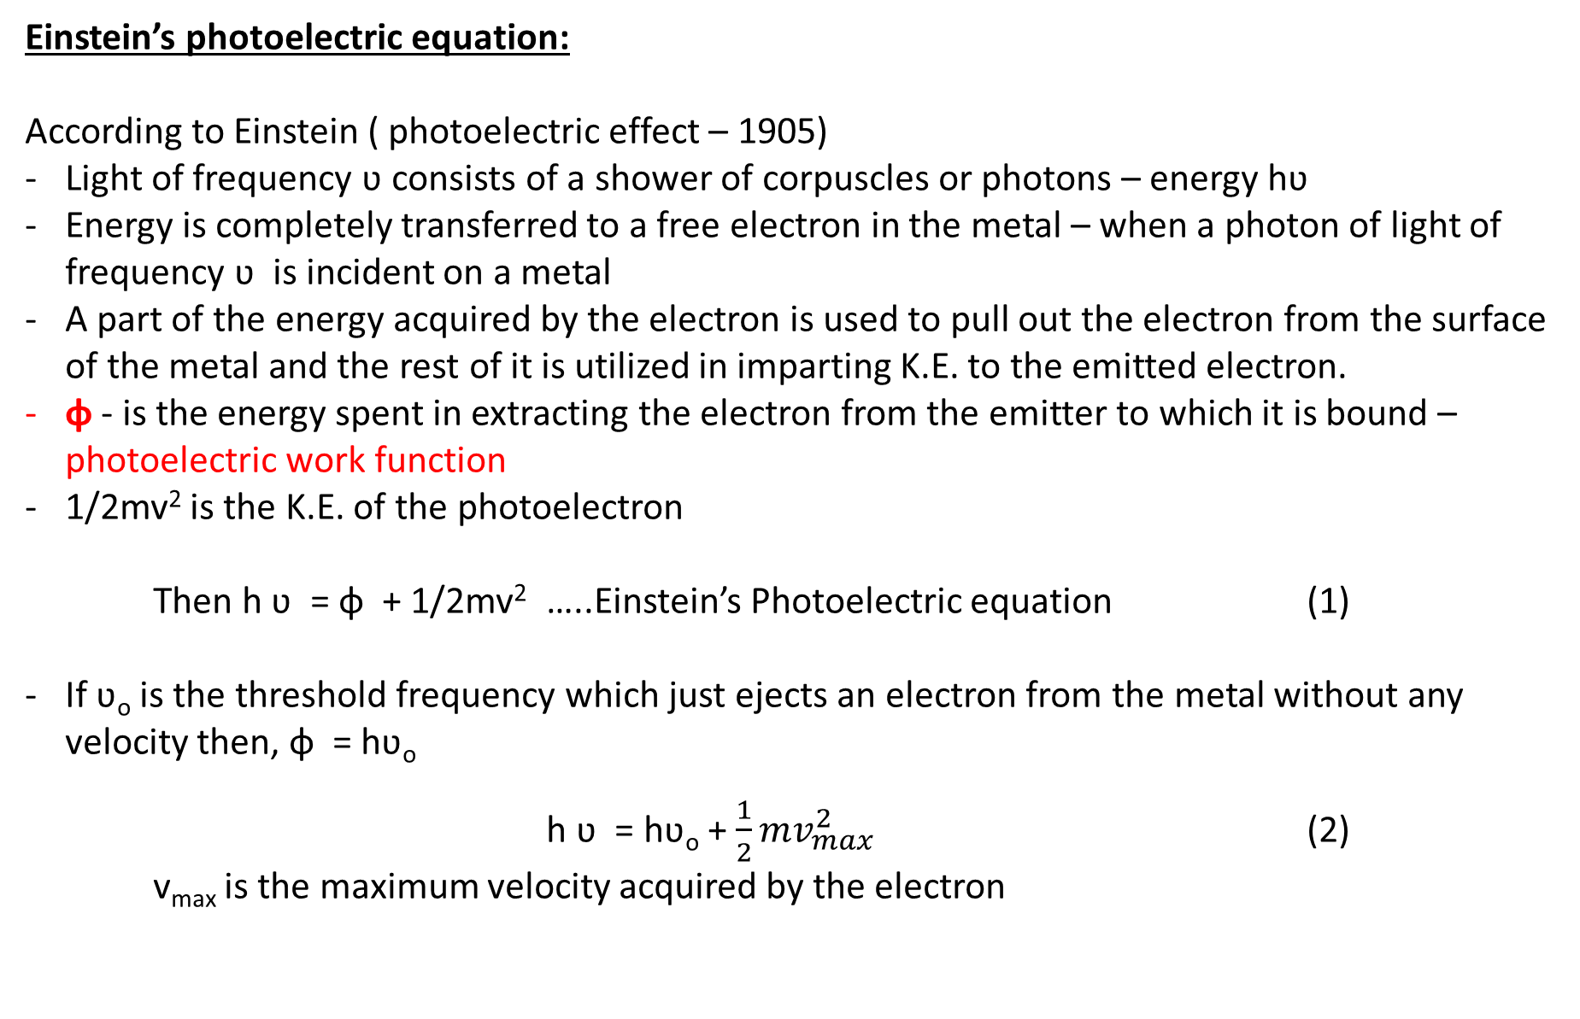
Einstein’s photoelectric equation:
According to Einstein ( photoelectric effect – 1905)
Light of frequency ʋ consists of a shower of corpuscles or photons – energy hʋ
Energy is completely transferred to a free electron in the metal – when a photon of light of frequency ʋ is incident on a metal
A part of the energy acquired by the electron is used to pull out the electron from the surface of the metal and the rest of it is utilized in imparting K.E. to the emitted electron.
ɸ - is the energy spent in extracting the electron from the emitter to which it is bound – photoelectric work function
1/2mv² is the K.E. of the photoelectron
Then h ʋ = ɸ + 1/2mv² …..Einstein’s Photoelectric equation (1)
If ʋ_{o} is the threshold frequency which just ejects an electron from the metal without any velocity then, ɸ = hʋ_{o}
h ʋ = hʋ_{o} + $\frac{1}{2}{mv}_{max}^{2}$ (2)
v_{max} is the maximum velocity acquired by the electron

Slide 19
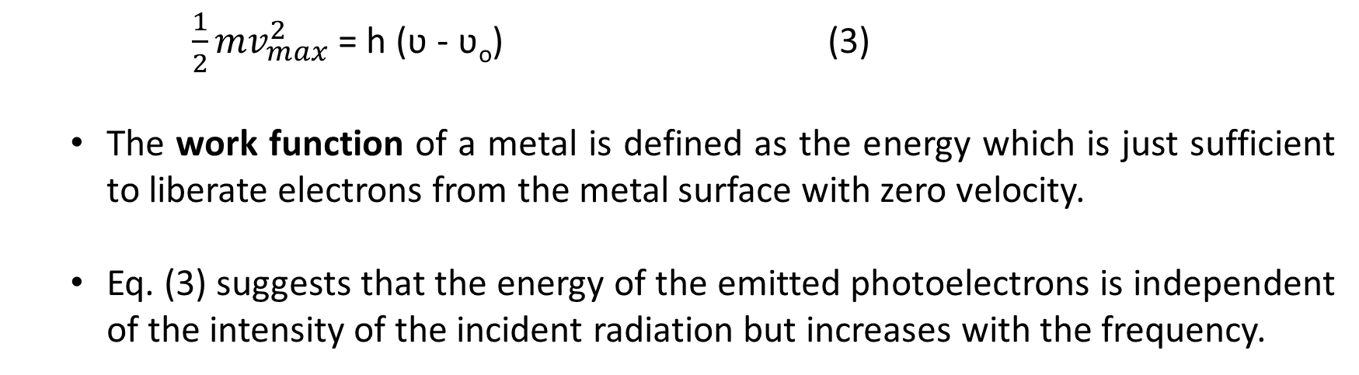
$\frac{1}{2}{mv}_{max}^{2}$ = h (ʋ - ʋ_{o}) (3)
The work function of a metal is defined as the energy which is just sufficient to liberate electrons from the metal surface with zero velocity.
Eq. (3) suggests that the energy of the emitted photoelectrons is independent of the intensity of the incident radiation but increases with the frequency.

Slide 20
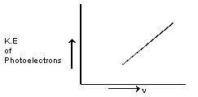
The kinetic energy of the photoelectrons increases linearly with the frequency of incident light. Thus, if the energy of the ejected electrons is plotted as a function of frequency, it result in a straight line whose slope is equal to Planck’s constant ‘h’ and whose intercept is hn₀­.

Slide 21
Energy Quanta
Photoelectric experiment results suggest that the energy in
light wave is contained in discrete energy packets, which are
called energy quanta or photon
The wave behaves like particles. The particle is photon
Planck’s constant: h = 6.625×10⁻³⁴ J-s
Photon energy = hν
Work function of the metal material = hν_{o}
Maximum kinetic energy of a photoelectron: T_{max}= h(ν-ν_{o})

Slide 22
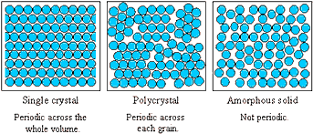
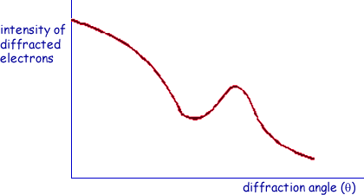
Electron’s Wave Behavior
Nickel sample
Electron beam
θ =0
θ
Scattered beam
θ =45º
θ =90º
Detector
The Davisson and Germer experiment demonstrated the wave nature of the electrons, confirming the earlier hypothesis of de Broglie.
Davisson-Germer experiment (1927)
Electron as a particle has wave-like behavior

Slide 23
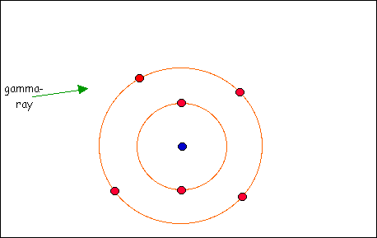
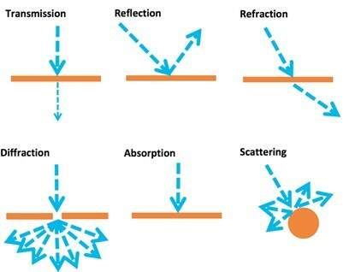
Compton Scattering
Compton Scattering
Elastic and inelastic collision
Definition: Compton shift
Theory

Slide 24
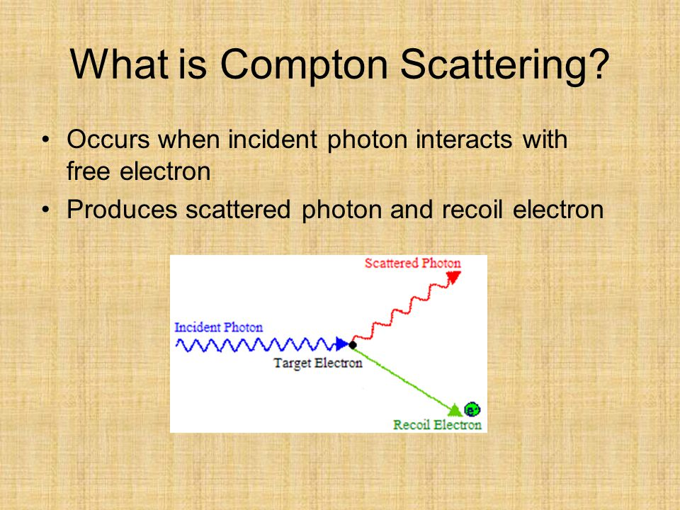
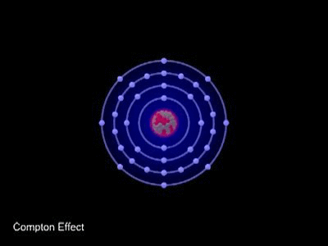

Slide 25
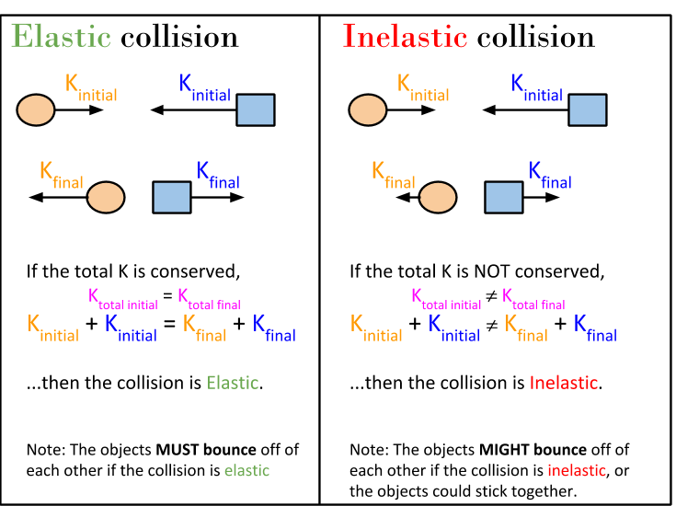
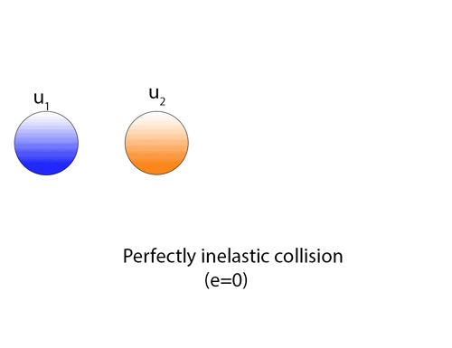
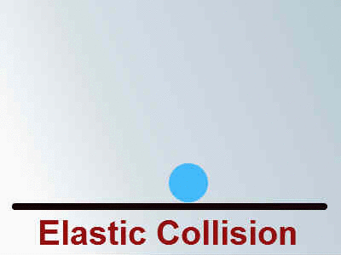

Slide 26
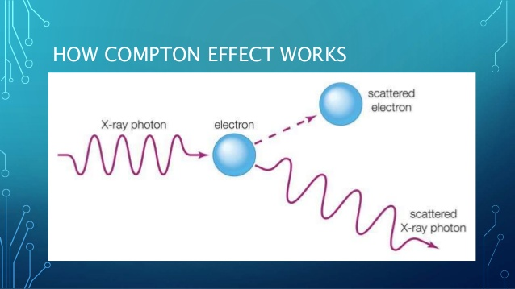
Compton Shift:
When a photon of energy ‘hʋ’ collides with an electron of a scatterer at rest – photon gives its energy to the electron.
The scattered photon have lesser energy/lower frequency/higher wavelength compared to the wavelength of incident photon.
The electron gains energy – it recoils with the velocity ‘ v ’ – this effect is called Compton effect and the shift in wavelength is called Compton shift.
Result of Compton scattering,
Unmodified radiations
Modified radiations
Recoil electron

Slide 27
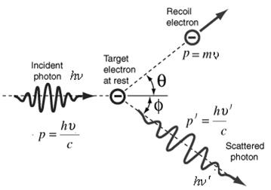
Compton effect: 1921 – A.H. Compton
- a beam of monochromatic radiation such as X-rays, γ – rays etc., of high frequency – fall on a fine scatterer, the beam is scattered into two components
(i) component having lower frequency/higher wavelength compared to incident radiation – modified radiation – scattered radiation
(ii) Recoil electron

Slide 28
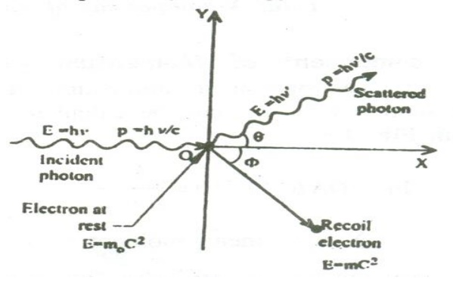
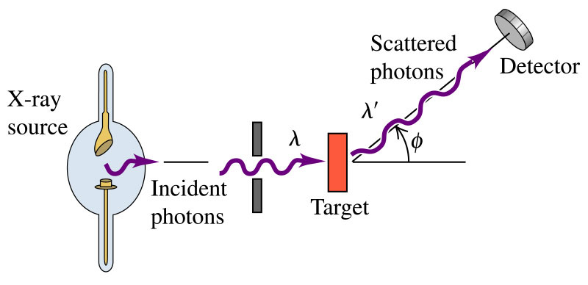
Theory of Compton effect
Principle & Working
in Compton scattering the collision between a photon and an electron is considered.
by applying the laws of conservation of energy and momentum – expression for Compton wavelength is derived
During the collision process – a part of energy is given to the electron – which in turn increases the K.E. of the electron – so it recoils at an angle of ɸ.
The scattered photon moves with an energy hʋˈ (less than hʋ), at an angle θ with respect to the original direction.

Slide 29
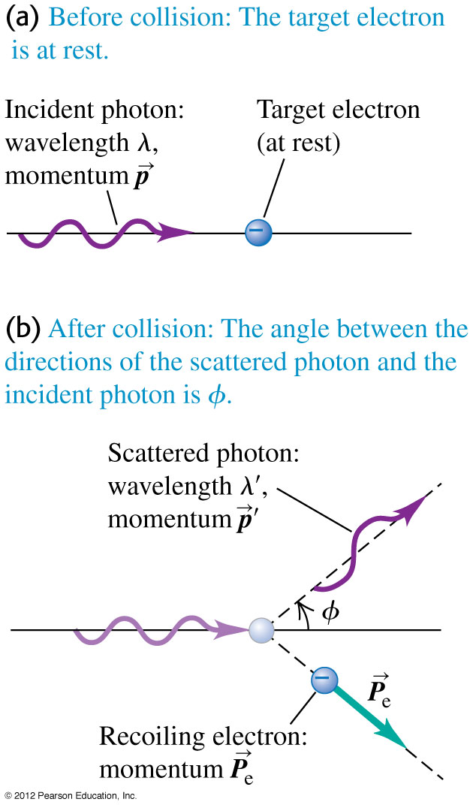
In the Compton experiment, x rays are scattered from electrons. The scattered x rays have a longer wavelength than the incident x rays, and the scattered wavelength depends on the scattering angle ϕ.
Explanation: When an incident photon collides with an electron, it transfers some of its energy to the electron. The scattered photon has less energy and a longer wavelength than the incident photon.

Slide 30
PHOTON
A photon is the smallest discrete amount or quantum of electromagnetic radiation. It is the basic unit of all light.
The discrete energy values in the form of small packets or bundles or quantas of definite frequency or wavelength are called photons.
These photons propagates like a particle with speed of light (3 x 10⁸ m/s)
As per Einstein’s light quantum theory, photons have energy equal to their oscillation frequency times Planck’s constant. Einstein proved that light is a flow of photons, the energy of these photons is the height of their oscillation frequency, and the intensity of the light corresponds to the number of photons. Essentially, he explained how a stream of photons can act both as a wave and particle. x

Slide 31
Photon properties:
The basic properties of photons are:
Zero mass and rest energy and exist as moving particles.
No electric charge.
Stable.
Carry energy and momentum which are dependent on the frequency.
Have interactions with other particles such as electrons, such as the Compton effect.
They can be destroyed or created by many natural processes, for instance when radiation is absorbed or emitted.
When in empty space, they travel at the speed of light.
Photons are similar to that of electrons
They do not ionise gas.
For electrons the definite quantities are ‘e’ and ‘m’. Similarly for photons the definite quantities are ‘h’ and ‘c’
Photons will not have any charge. They are neutral and hence they are not affected by magnetic (or) electric field.
Energy of the photon is given by E = hʋ, which varies w.r.t the type of radiation frequencies.
The momentum of photon is given by p =m/ λ
The relation between energy and the momentum of the photon is given by
E = m c²
m = E/ c²
m = hʋ / c² = h /c λ
the momentum of the photon is given by,
p = mc = (hʋ / c²) x c = hʋ / c = h / λ

Slide 32
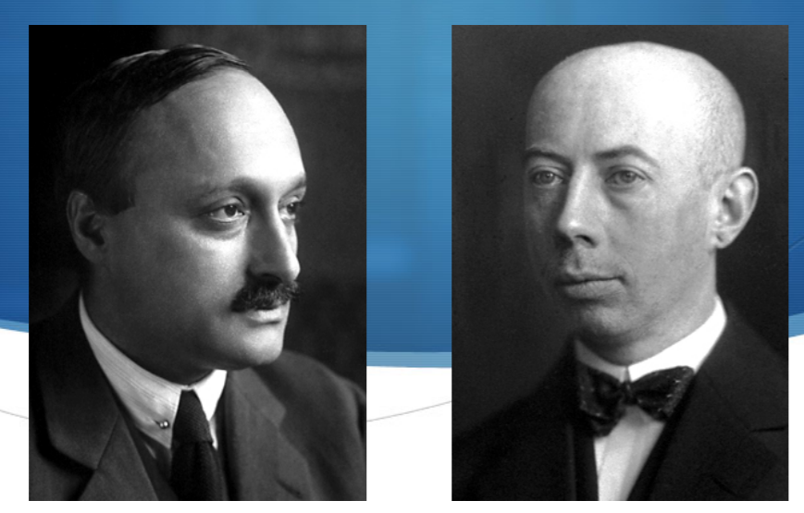
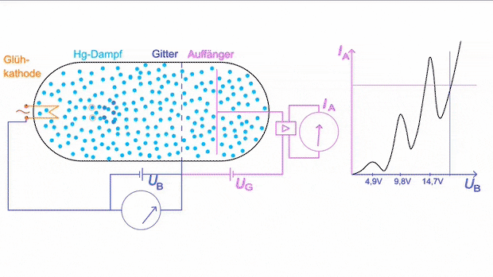
Franck-Hertz experiment

Slide 33
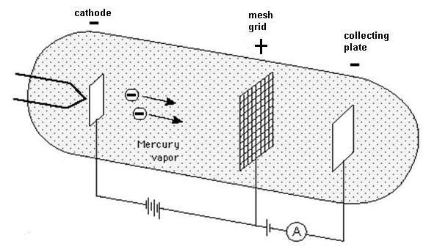
Construction:

Slide 34
Theory & Explanation:
It demonstrate the existence of excited states in mercury atoms.
It confirms the prediction of quantum theory that electrons occupy only discrete, quantized energy states.
This experiment supports Bohr model of atom. For this great invention they have been awarded Nobel Prize in Physics in the year 1925.
The electrons transfer their KE during inelastic collisions with atoms in discrete packets.
With the help of thermionic emission, electrons are emitted by a heated cathode, and then accelerated toward a grid which is at a positive potential, relative to the cathode.
The collecting plate is at a lower potential and is negative with respect to mesh grid.

Slide 35
If electrons have sufficient energy on reaching the grid, some will pass through the grid, and reach collecting plate, and it will be measured as current by the ammeter.
Electrons which do not have sufficient energy on reaching the grid will be slowed down, and will fall back to the grid. The experimental results confirm the existence of discrete energy levels.
As long as the electron collision is elastic, the electrons will not lose energy on colliding with gas molecules in tube.
As the accelerating potential increases, the current also increases.
But as the accelerating potential reaches a particular value, (4.9eV for mercury, 19eV for neon), each electron possess that much of potential and now the collision become inelastic.
As a result, the energy level of electron bound to the atom is raised. Now the electron almost loses its energy, and measured current drops.

Slide 36
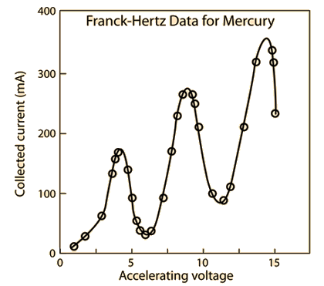
https://www.vascak.cz/data/android/physicsatschool/template.php?s=atom_franckhertz&l=en

Slide 37
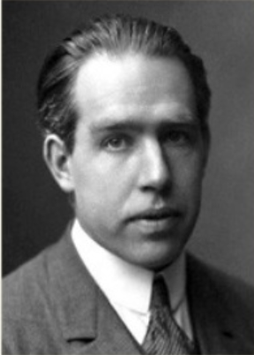
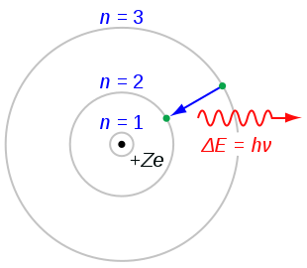
Bohr Atom Model
Introduction:
Bohr assumed basically Rutherford nuclear-model
It overcomes the defect of the Rutherford model
Basic Postulates:
An electron cannot revolve round the nucleus in all possible orbits
The electron can revolve round the nucleus only in those allowed or permissible orbits – angular momentum of the electron is an integral multiple of ħ (ħ is the Planck’s constant)
ħ = h /2π
These orbits are called stationary orbits and an electron revolving in these orbits does not radiate energy – non-radiating paths of electrons.

Slide 38
As we know it the atom is made up of neutrons, protons, and electrons.
While the neutrons (no charge), and the protons (positive charge) make up the nucleus of the atom, the electron (negative charge) circle around the nucleus much like the orbiting of planets around the sun.
According to Rutherford Model electrons are in constant motion around the nucleus while emitting energy.
According to this idea as the electrons lost energy they would get closer and closer to the nucleus and eventually crash into it.
This problem was solved when Niles Bohr created a model of a hydrogen atom. Bohr decided to formulate an atom that would correct the instability problems of the Rutherford Model.

Slide 39
Electrons move around the nucleus of an atom in circular motion.
Electrons have a set number of orbitals, ring-like paths around the nucleus, they can travel in called stationary states. If the electron stays in one orbital, the energy of the electron remains constant. The first orbital is n=1, the second orbital n=2 and so on. (These values of n are called quantum numbers.)
Electrons can only move from one orbital to another allowed orbital at one time. If an electron drops down from n=2 to n=1 energy is emitted, and if the electron moves up from n=1 to n=2 energy is absorbed. The amount of energy that is either absorbed or emitted is called quanta.
n = 2
n = 1
n = 3

Slide 40
The energy of a photon, lost or gained, is calculated using Planck's equation:
(h is Planck's constant, 6.62607 x 10⁻³⁴ J s / cycles, and v stands for frequency in cycles/s)
Energy Difference (ΔE) = hν
Bohr's model allows us to calculate the radii of the orbits that are allowed for an electron to travel.
It also allows us to calculate electron velocities and energy in these orbits.
With the equation below we can calculate allowed energy levels for a Hydrogen atom. (R_{H} is a constant value of 2.179 x 10⁻¹⁸Joules)
E_{n}=−R_{H} (1/n²)

Slide 41
When an electron drops from a higher level for example from n=2 to a lower energy level, n=1, it emits a specific wavelength distinct to that element.
To calculate the difference between the two energy levels, the equation below is used. Subscript i stands for initial, (initial energy= E_{i} and initial quantum number= n_{i}) while subscript f stands for final (final energy= E_{f} and final quantum number= n_{f}).
Energy Difference
The Bohr model also helps us understand how cations are made. This is through the concept of Ionization Energy, the energy to remove an electron from its ground state.
After the electron is free, the atom is ionized.

Slide 42
ELECTRON DIFFRACTION
The wave-particle duality of nature results in particles having both wave-like and particle-like properties.
The wave-like properties of objects means that we can perform diffraction using them, as with X-ray photons.
However, this time we extend from massless particles to those with mass, including the electron and the neutron.
In this case, the wavelength of an electron is given by the de Broglie relation, as shown in equation
where h is Planck's constant and p is the electron momentum. As the momentum is related to the velocity and, in turn, the velocity is dependent upon the accelerating force i.e. an electric potential we see that equation can be written

Slide 43
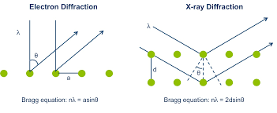
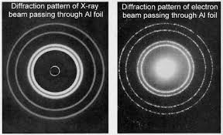
where m₀ is the mass of the electron and U is the electric potential through which the electron is accelerated.

Slide 44
Wave - Particle duality of radiation and matter
The dual nature of matter and the dual nature of radiation were revolutionary concepts of physics.
In case of light some phenomenon like diffraction and interference can be explained on the basis of its wave character.
However, the certain other phenomenon such as black body radiation and photoelectric effect can be explained only on the basis of its particle nature.
Thus, light is said to have a dual character. Such studies on light were made by Einstein in 1905.
Louis de Broglie, in 1924 extended the idea of photons to material particles such as electron and he proposed that matter also has a dual character-as wave and as particle.

Slide 45
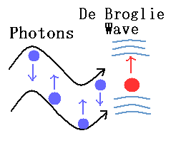
Derivation of de-Broglie Equation
The wavelength of the wave associated with any material particle was calculated by analogy with photon.
In case of photon, if it is assumed to have wave character, its energy is given by
E = hv …(i)
(According to the Planck’s quantum theory)
Where ν frequency of the wave and ‘h’ is is Planck’s constant
If the photon is supposed to have particle character,
its energy is given by
E = mc² ….… (ii)
(according to Einstein’s equation)
where ‘m’ is the mass of photon, ‘c’ is the velocity of light.

Slide 46
By equating (i) and (ii)
hv = mc²
But v = c/λ
h c/λ = mc²
(or) λ = h /mc
The above equation is applicable to material particle if the mass and velocity of photon is replaced by the mass and velocity of material particle. Thus for any material particle like electron.
λ = h/mv or λ = h/p
where mv = p is the momentum of the particle.

Slide 47
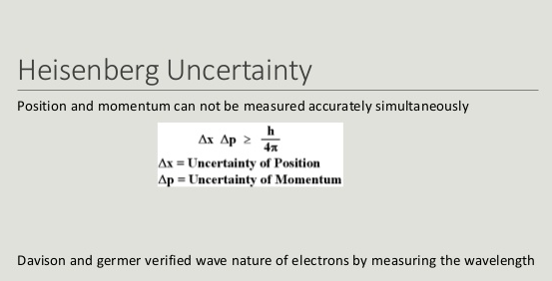

Slide 48
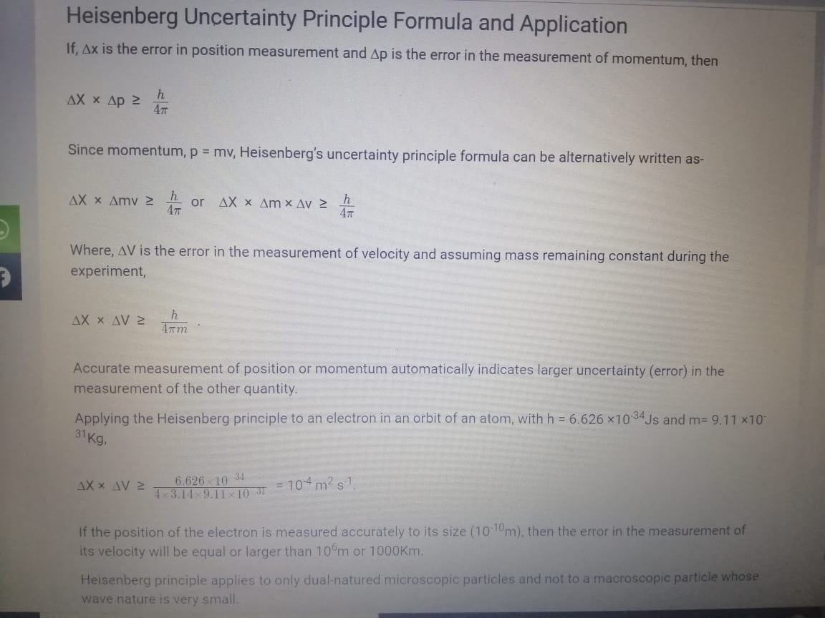

Slide 49
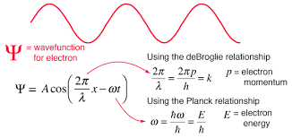
Wavefunction (ψ (“psi”))
Quantum mechanics acknowledges the wave-particle duality of matter by supposing that, rather than traveling along a definite path, a particle is distributed through space like a wave. The wave that in quantum mechanics replaces the classical concept of particle trajectory is called a wavefunction, ψ (“psi”).
A wave function in quantum mechanics describes the quantum state of an isolated system of one or more particles. There is one wave function containing all the information about the entire system, not a separate wave function for each particle in the system.

Slide 50
A wave function is defined to be a function describing the probability of a particle's quantum state as a function of position, momentum, time, and/or spin.
Wave functions are commonly denoted by the variable Ψ.
A wave function may be used to describe the probability of finding an electron within a matter wave.
To do this, the wave function, which may include an imaginary number, is squared to yield a real number solution. Then, the probability of an electron being within a certain area can be assessed.
The famous Schrodinger equation introduced the wave function concept in 1925.

Slide 51
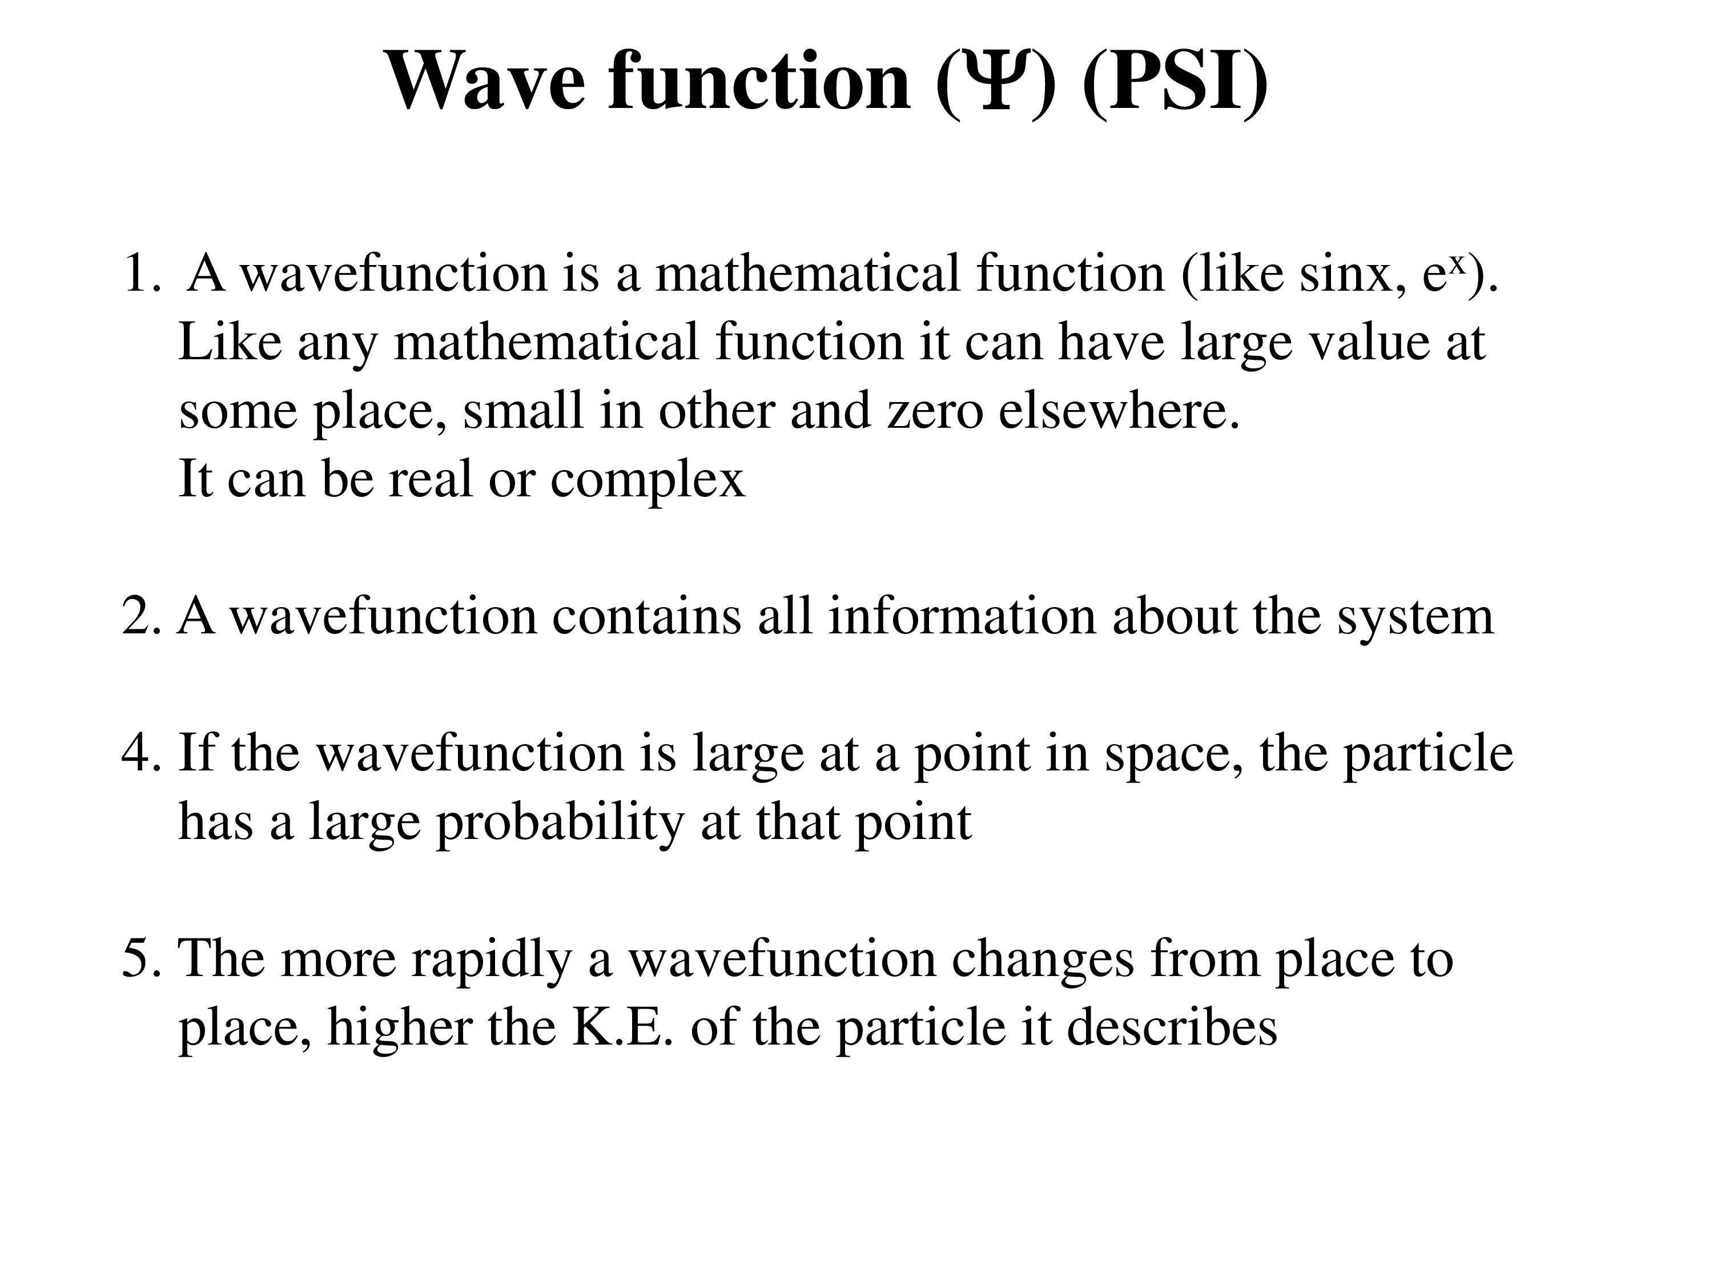
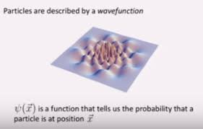

Slide 52
Physical interpretation of a wave function
The physical meaning of the wave function is an important interpretative problem of quantum mechanics. The standard assumption is that the wave function of an electron is a probability amplitude, and its modulus square gives the probability density of finding the electron in a certain location at a given instant.
A wave function of quantum mechanical system is some thing associated with its wave nature.
To arrive at results consistent with real time observations, we have imposed several requirements on the wave function of a quantum mechanical system.
Wave function is a quantity which describe the particle.
Wave function must be single valued and continuous everywhere and it should approach to zero as r is tending to infinity.

Slide 53
It is a mathematical function that describes some of the properties of the wave. The shape of the wave is described by the sine function, and the amplitude describes strength (intensity) of the wave. The wave function can be interpreted as ψ(r, t). r means (x, y, z)
ψ = A sinθ
The probability of finding a particle at a position x₁<x>x₂ and time t
OR
The probability per unit length of finding the particle at the position r at time t. ψ*(r,t) is complex conjugate of ψ(r,t)

Slide 54

Requirements for an Acceptable Wavefunction
The wave function ψ must be continuous.
All its partial derivatives must also be continuous (partial derivatives are $\left(\frac{∂ψ}{∂x}, \frac{∂ψ}{∂y}etc.\right)$ ) This makes the wave function "smooth”.
The wave function ψ must be quadratically integrable. This means that the integral ∫ψ*ψ dτ must exist.
Since ∫ψ*ψ dτ is the probability density, it must be single valued.

Slide 55
The wave functions must form an orthonormal set. This means that the wave functions must be normalized.
The wave functions must be orthogonal.

Slide 56
Properties of Wave Function
All measurable information about the particle is available.
𝚿 should be continuous and single-valued.
Using the Schrodinger equation, energy calculations becomes easy.
Probability distribution in three dimensions is established using the wave function.
The probability of finding a particle if it exists is 1.

Slide 57


Slide 58
Schrödinger Wave Equation
Schrodinger wave equation describes the wave nature of a particle in mathematical form. It is the basis equation of wave mechanics originally proposed by Austrian Scientist Erwin Schrödinger.
Schroedinger connected the expression of De-Broglie wavelength with the classical wave equation for a moving particle and obtained a new wave equation.
Forms of Schrödinger wave equation
There are two forms of Schrödinger wave equation. They are
i) Time independent wave equation
ii) Time dependent wave equation

Slide 59

Schroedinger’s time independent wave equation (Stationary states)
According to De-Broglie’s hypothesis, a particle of mass m moving with velocity v is always associated with a wave whose wavelength is given by $λ= \frac{h}{mv}$. If the particle has wave properties, then it is expected that there should be some sort of wave equation to describe the behaviour of the particle.
The classical differential equation of wave system is
$\frac{∂^{2}Ψ}{{∂x}^{2}}+ \frac{∂^{2}Ψ}{{∂y}^{2}}+ \frac{∂^{2}Ψ}{{∂z}^{2}}= \frac{1}{v^{2}}\frac{∂^{2}Ψ}{{∂t}^{2}}$ ... (1)
where Ψ is wave displacement for De-Broglie’s waves at time t;
x,y,z are coordinates of the particle ; and v is wave velocity

Slide 60


Equation (1) may be rewritten as
$∇^{2}Ψ= \frac{1}{v^{2}}\frac{∂^{2}Ψ}{{∂t}^{2}}$ ... (2)
where $∇^{2}Ψ= \frac{∂^{2}}{{∂x}^{2}}+ \frac{∂^{2}}{{∂y}^{2}}+ \frac{∂^{2}}{{∂z}^{2}}$ is Laplacian operator.
The solution of equation (2) gives the periodic displacement in terms of time t,
i.e. $Ψ \left(x,y,z,t\right)= Ψ_{0}\left(x,y,z\right)e^{−iωt}$ ... (3)
where $Ψ_{0 }$is amplitude at the point considered . It is a function of position and not of time (t).
Differentiating equation (3) twice with respect to t, we get
$$\frac{∂Ψ}{∂t}= −i ω Ψ_{0}e^{−iωt}$$
and $\frac{∂^{2}Ψ}{{∂t}^{2}}=\left(−iω\right)\left(−iω\right)Ψ_{0}e^{iωt}= i^{2}ω^{2}Ψ_{0}e^{−iωt}$ ... (4)
= $−ω^{2} Ψ$ [ $i^{2}= −1]$

Slide 61


Substituting this in equation (2), we get
$∇^{2}Ψ= − \frac{ω^{2}}{v^{2}} Ψ$ ... (5)
or $∇^{2}Ψ+\frac{4π^{2}}{λ^{2 }} Ψ=0$ ... (6)
$∇^{2}Ψ+\frac{4π^{2}m^{2}v^{2}}{h^{2 }} Ψ=0$ ... (7)
If E is total energy of the particle, V is potential energy and $\frac{1}{2}mv^{2}$ is kinetic energy, then
E = P.E. + K.E.
i.e., E = V + $\frac{1}{2}mv^{2}$ or $E−V= \frac{1}{2}mv^{2}$
$$mv^{2}=2(E−V)$$

Slide 62


Multiply m on both sides
or $m^{2}v^{2}=2m \left(E−V\right)$ ... (8)
Substituting equation (8) in equation (7) , we get
$∇^{2}Ψ+\frac{8π^{2}m}{h^{2 }}(E−V) Ψ=0$ ... (9)
This $Ψ$ is independent of time. This is the steady state (stationary state) form of Schroedinger equation. The equation is known as Schroedinger’s time independent wave equation.
If we consider one-dimensional motion, i.e., particle moving along x-direction only, then Schroedinger’s equation (9) reduces to
$\frac{d^{2}Ψ(x)}{{dx}^{2}}+\frac{8π^{2}m}{h^{2 }}\left(E−V\right)Ψ(x)=0$ ... (10)

Slide 63

Taking $ћ= \frac{h}{2π}$ (where $ћ$ is a reduced Planck’s constant) in equation (9), Schroedinger’s wave equation may be rewritten as
$∇^{2}Ψ+\frac{2m}{ћ^{2 }}(E−V) Ψ=0$ ... (11)

Slide 64


Schroedinger’s time dependent wave equation
We can easily derive Schroedinger’s time dependent wave equation by eliminating ‘E’ from Schroedinger’s time independent wave equation.
Differentiating equation (3) with respect to time t, we get
$\frac{∂Ψ}{∂t}= −i ω Ψ_{0}e^{−iωt}= −i \left(2πν\right)Ψ_{0}e^{−iωt}$ ($ω= 2πν)$
$= −2π i ν Ψ= −i 2π\frac{E}{h} Ψ$ ($ν= \frac{E}{h} )$
$$∴ \frac{∂Ψ}{∂t}= −i \frac{E}{\frac{h}{2π}} Ψ= −i \frac{E}{ћ} Ψ$$
Multiplying i on both sides,
$$i\frac{∂Ψ}{∂t}= −i ×i \left[\frac{E}{ћ}\right] Ψ$$

Slide 65


$$i\frac{∂Ψ}{∂t}= \frac{E}{ћ} Ψ$$
or $E Ψ=i ћ \frac{∂Ψ}{∂t}$ ... (12)
Substituting the value of $E Ψ$ from eq. (12) in Schroedinger’s time independent wave equation (11), we have
$$∇^{2}Ψ+\frac{2m}{ћ^{2 }}(E−V) Ψ=0$$
$$∇^{2}Ψ+\frac{2m}{ћ^{2 }}(EΨ−VΨ) =0$$
$$∇^{2}Ψ+\frac{2m}{ћ^{2 }}(i ћ \frac{∂Ψ}{∂t}−VΨ) =0$$
$$∇^{2}Ψ= \frac{−2m}{ћ^{2 }}(i ћ \frac{∂Ψ}{∂t}−VΨ)$$
$− \frac{ћ^{2}}{2m}∇^{2}Ψ+VΨ= i ћ \frac{∂Ψ}{∂t}$ ... (13)
This equation is known as derive Schrodinger’s time dependent wave equation.

Slide 66

$− \frac{ћ^{2}}{2m}∇^{2}Ψ+VΨ= i ћ \frac{∂Ψ}{∂t}$
$i ћ \frac{∂Ψ}{∂t}$ = [ $V −\frac{ћ^{2}}{2m}∇^{2}$] $Ψ$ ... (14)
E$Ψ$ = H$Ψ$ … (15)
where, E is the energy operator given by E =$i ћ \frac{∂}{∂t}$
H is called Hamiltonian Operator, given by H = $V −\frac{ћ^{2}}{2m}∇^{2}$
This equation is known as derive Schrodinger’s time dependent wave equation.

Slide 67


Particle in one – Dimensional box
Consider a particle of mass ‘m’ moving inside a box along the x-axis.
This particle is bouncing back and forth between the two rigid walls of the box at x = 0 and x = a.
While moving, the particle may collide with the walls and undergo perfectly elastic collisions.
Due to elastic collisions, there is no change in energy. The potential energy (V) of the particle inside the box is constant and may be taken as zero.
The walls are infinitely high, and the particle cannot come out of the box. The potential energy outside the box is infinite.

Slide 68

V(x) = 0 for 0 < x < a
V(x) = ∞ for 0 ≥ x ≥ a

Slide 69


Thus, potential function V(x) is expressed as
V(x) = 0 for 0 < x < a
V(x) = ∞ for 0 ≥ x ≥ a
This potential function is known as square well potential.
The particle cannot move out of the box. Also, it cannot exist on the walls of the box. So its wave function Ψ is 0 for x ≤ 0 and x ≥ a. Our task is to find Ψ within the box (i.e.) b/w x = 0 and x = a.
Within the box at V = 0, the Schrodinger equation can be written as:
$\frac{d^{2}Ψ}{{dx}^{2}}+ \frac{2mE}{ћ^{2}}Ψ=0$ ... (1)
$\frac{d^{2}Ψ}{{dx}^{2}}+ k^{2}Ψ=0$ ... (2)
where $k^{2}= \frac{2mE}{ћ^{2}}$

Slide 70

The general solution of equation (2) is
$Ψ\left(x\right)= A sinkx+B\cos{kx}$ ... (3)
The boundary conditions are used to evaluate the constants A and B in eq. (3),
At x = 0, $Ψ$ = 0 and hence B must be zero.
i.e. 0 = A sin 0 + B cos 0
0 = 0 + B = B
B = 0
At x = a, $Ψ$ = 0
0 = A sin ka + B cos ka
0 = A sinka
Either A = 0 or sinka = 0.

Slide 71


‘A’ cannot be ‘0’ since one of the constants B is already ‘0’.
sinka = 0
Hence, ka = nπ $k= \frac{nπ}{a}$ where n is an integer ( 1, 2, 3, ... )
$Ψ_{n}\left(x\right)=A\sin\left[\frac{nπx}{a}\right]$ + 0
We know that , $k^{2}= \frac{2mE}{ћ^{2}}$ = $\frac{2mE}{{h^{2}}/{{4π}^{2}}}$ = $\frac{8π^{2}mE}{h^{2}}$
$\frac{n2π2}{a2}$ = $\frac{8π^{2}mE}{h^{2}}$
E_{n} = $\frac{n^{2}h^{2}}{8ma^{2}}$
Each value of E_{n} is called as Eigen value and the corresponding $Ψ_{n}$ is called as eigen function.
For each value of n there is an energy level. So it is very clear that the particle can have the discrete energy values. Hence the energy of the particle is quantized.

Slide 72


Eigen Values of Energy
The energy of the particle is given by
Therefore the eigen values of the energy E of the particle are
For n = 1
For n = 2

Slide 73

Normalisation of wavefunction
To find A
The wave functions corresponding to the above allowed discrete energy levels can be obtained as follows.
Probability density is given by ${\left|φ\right|}^{2} = φ^{∗}$ $φ$
${\left|φ\right|}^{2} = A2sin2\left[\frac{nπx}{a}\right]$
The probability of finding the particle inside the box of length a is,
$\int_{0}^{a}{φ^{∗} φ dx = 1 }$ (the particle is always within the box)
Sub. The value of $φ^{∗}$ $φ$ from eq.1, we have

Slide 74


$$\int_{0}^{a}{A2sin2\left[\frac{nπx}{a}\right] dx = 1 }$$
$$A2 \int_{0}^{a}{\frac{\left(1 −\cos{\frac{2nπx}{a}}\right)}{2} dx = 1 }$$
$$A^{2} \left[\int_{0}^{a}{\frac{1}{2} dx − \frac{1}{2} \int_{0}^{a}{\cos{\frac{2nπx}{a}} dx}}\right] = 1$$
$A^{2} \left[\left[ {\left[\frac{x}{2}\right]}_{0}^{a} \right]− \frac{1}{2} {\left[\frac{\sin{\frac{2πnx}{a}}}{\frac{2nπ}{a}}\right]}_{0}^{a}\right]$ = 1
$A^{2}$ ${\left[\frac{x}{2}\right]}_{0}^{a}$ = 1 $\frac{A^{2} a}{2}$ = 1
$A^{2}$ = $2/{a }$ or A = $\sqrt{2/a}$
The eigen function ($Ψ_{n}$) belonging to eigen values E_{n} is expressed as
$$Ψ_{n}= \sqrt{2/a}\sin\left[\frac{nπx}{a}\right]$$
This is known as normalized eigen function.

Slide 75
Eigen Functions
From the wave function (1) we have various eigen function, They are

Slide 76

The Generalised wave function ψ₁, ψ₂, ψ₃ are shown in the figure

Slide 77


Square well potential in 1D – with one finite potential barrier (one step potential)
Consider the particle in a 1D box of length ‘L’ with the modification that one of the walls at the end x = L has a finite height (Vo) and the other end x = 0 has infinite height (V= ∞).
Between x = 0 to x = L, the potential energy V = 0. This system is termed as a “Potential Well” and it is now divided into regions I & II where V =0 and V = Vo respectively.

Slide 78


The schrodinger equations for the 2 regions is given by:
For Region –I; V =0
(1)
For Region –II; V =V₀
(2)

Slide 79


The general solutions of equations (1) and (2) takes the form
(x < 0) ... (3)
And
(x > 0) ... (4)
Where, and are the wave function for the region I and II
A, B, C and D are constants of integration which may be found boundary conditions.
and
... (5)

Slide 80
In eq. (3),
first term – represents a wave moving in positive direction of x- axis (i.e) incident wave - in Region I
second term – represents a wave moving in negative direction of x- axis (i.e) reflected wave - in Region I
In eq. (4),
first term – represents a wave moving in positive direction of x- axis (i.e) transmitted wave - in Region II
second term – represents a wave moving in negative direction of x- axis (i.e) reflected wave - in Region II
The reflection will not take place in region – II, (i.e.) D =0. Hence, eq. (4) becomes,
… (6)

Slide 81


Boundary conditions,
The continuity of Ψ and implies that
0
$\frac{dφ_{1}}{dx} =\frac{dφ_{2}}{dx}$ = 0
${ φ}_{1}= φ_{2}$
$\frac{dφ_{1}}{dx} =\frac{dφ_{2}}{dx}$
at x = 0
at x = L
On applying boundary condition to eq.3 and 4
${ φ}_{1}=A e^{ik_{1}x}$ + B $e^{−ik_{1}x}$
0 = $A e^{0}$ + B $e^{0}$ = A + B
$${ φ}_{2}=C e^{ik_{2}x}$$
0 = $C e^{o}$ = C
A + B = C
… (7)

Slide 82



And $k_{1}A− k_{1}B= k_{2}C$
… (8)
Putting the value of C in equation (8), we have
$$k_{1}A− k_{1}B= k_{2}(A+B)$$
$$\left(k_{1}−k_{2}\right)A=\left(k_{1}+k_{2}\right)B$$
Which gives $B= \left(\frac{k_{1}−k_{2}}{k_{1}+k_{2}}\right)A$ ... (9)
Putting the value of B from equation (9) in equation (7), we get
$$A+\frac{\left(k_{1}−k_{2}\right)}{\left(k_{1}+k_{2}\right)}A=C$$
Which gives C $= \left(\frac{2k_{1}}{k_{1}+k_{2}}\right)A$ ... (10)
In this case B and C represent the amplitudes of reflected and transmitted beam respectively in terms of amplitude of incident wave.

Slide 83

The reflectance and the transmittance at the potential discontinuity is defined as,
$R\text{eflectance} \text{R}\text{ = }\frac{magnitude of reflected current}{magnitude of incident current}$
$\text{Transmittance} \text{T}\text{ = }\frac{magnitude of transmitted current}{magnitude of incident current}$
Reflection coefficient $R= \frac{Magnitude of reflected flux}{Magnitude of incident flux}= \frac{Nr}{Ni}$
Transmission coefficient T$= \frac{Magnitude of transmitted flux}{Magnitude of incident flux}= \frac{Nt}{Ni}$
Now ψψ* represents the probability density. Let v be the velocity of a stream of particles then ψψ*v represents the current density i.e., number of particles crossing unit area placed perpendicular to the direction of motion. If N_{i} be the incident flux, then we have by definition

Slide 84



Case (i) E > V₀
(a) Region I :
$N_{i}= {\left|A Ψ_{i}Ψ_{i}^{∗}\right|}^{2}ν= {\left|A\right|}^{2} v={\left|A\right|}^{2}\frac{k_{1}ℏ}{m}$
… (11)
Similarly the reflected flux N_{r} is given by the relation
$$N_{r}= {\left|B\right|}^{2} v={{\left|\left(\frac{k_{1}−k_{2}}{k_{1}+k_{2}}\right)\right|}^{2}\left|A\right|}^{2}\frac{k_{1}ℏ}{m}$$
… (12)
(b) Region II :
… (13)

Slide 85

We have from equation (11), (12) and (13)
N_{t} + N_{r} = N_{i}
So quantum mechanically, there is some probability of reflection and some probability of transmission. The reflection coefficient R and transmission coefficient T are defined as under
Reflection coefficient $R= \frac{Magnitude of reflected flux}{Magnitude of incident flux}= \frac{Nr}{Ni}$
$$= {\left(\frac{k_{1}−k_{2}}{k_{1}+k_{2}}\right)}^{2}$$

Slide 86


Transmission coefficient T$= \frac{Magnitude of transmitted flux}{Magnitude of incident flux}= \frac{Nt}{Ni}$
$$= \frac{4k_{1}k_{2}}{{(k_{1}+ k_{2})}^{2}}$$
So we have $T+R= \frac{4k_{1}k_{2}}{{(k_{1}+ k_{2})}^{2}}+ \frac{{(k_{1}− k_{2})}^{2}}{{(k_{1}+ k_{2})}^{2}}=1$
Case (ii) E < V₀
T = 0
R + 0 = 1
R =1
It is evident that the entire wave gets reflected when E<V0 (i.e.) no electrons are transmitted but all are reflected.

Slide 87
Application Of Barrier Penetration
Alfa Decay
Field Ionization
Scanning Tunnelling Microscope

Slide 88

Alfa Decay
According to classical ideas, a particle striking a hard wall has no chance of leaking through it.
But the behavior of a quantum particles different due to the wave nature associated with it.
We know that when an electromagnetic wave strikes at the interface of two media, it is partly reflected and partly transmitted through the interface and enters the second medium.
In a similar way the de Broglie wave also has a possibility of getting partly reflected from the boundary of the potential well and partly penetrating through the barrier.

Slide 89



Slide 90


It represents a potential barrier of height V and thickness L. A potential barrier is the opposite of a potential well; it is a potential-energy function with a maximum. The potential energy is zero for x < 0 and x > L has a value V for 0 < x < L. An electron of total energy E approaches the barrier from the left.

Slide 91
From the view-point of classical physics, the electron would be reflected from the barrier because its energy E is less than V.
For the particle to overcome the potential barrier, it must have an energy equal to or greater than V.
Quantum mechanics leads to an entirely new result. It shows that there is a finite chance for the electron to leak to the other side of the barrier.
We say that the electron tunnelled through the potential barrier and hence in quantum mechanics, the phenomenon is called tunnelling.
Tunnelling is significant in many areas of physics.
The tunnel diode is a semiconductor diode in which electrons tunnel through a potential barrier.
The current can be switched on and off very quickly be varying the height of the barrier, which is done with an applied voltage.
The scanning tunnelling electron microscope uses electron tunnelling to produce images of surfaces down to the scale of individual atoms.
The quantum possibility of penetrating potential barriers is the basis of the explanation of the α – decay of radioactive nuclei.

Slide 92

The α particle tunnels through a region of space it is forbidden to be in, and it comes out of the side of the nucleus.
Like an electron making a transition between orbits around an atom, it travels from one point to another without ever having been in between.

Slide 93

The wave function of a quantum mechanical particle varies smoothly, going from within an atomic nucleus (on one side of a potential energy barrier) to outside the nucleus (on the other side of the potential energy barrier).
Inside the barrier, the wave function does not become zero but decreases exponentially, and we do not observe the particle inside the barrier.
The probability of finding a particle is related to the square of its wave function, and so there is a small probability of finding the particle outside the barrier, which implies that the particle can tunnel through the barrier.

Slide 94


Scanning Tunneling Microscopy (STM)

Slide 95
A metal tip made up of tungsten is placed between a very small distances above a conducting or semiconducting surface.
This distance acts as a potential barrier for tunnelling. The space between the tip and the surface normally is vacuum.
When electrons tunnel from the metal tip to the surface, a current is created and monitored by a computer (Figure 1).
The current depends on the distance between the tip and the surface, which is controlled by a piezoelectric cylinder.
When there is a strong current, the tip will move away from the surface.
The increase of the potential barrier will decrease the probability of tunnelling and decrease the current.
If the current becomes too weak, the tip moves closer to the surface.
The potential barrier will be reduced and the current will increase.
The variations in the current as the tip moves over the sample are reconstructed by the computer to produce topological image of the scanned surface.

Slide 96

Field emission
Field emission - also called Fowler-Nordheim tunneling - is the process whereby electrons tunnel through a barrier in the presence of a high electric field. This quantum mechanical tunneling process is an important mechanism for thin barriers as those in metal-semiconductor junctions on highly-doped semiconductors.

Slide 97

Field emission is a process of emitting electrons from conducting surfaces due to a strong external electric field that is applied in the direction normal to the surface (Figure 1).
As we know from our study of electric fields in earlier, an applied external electric field causes the electrons in a conductor to move to its surface and stay there as long as the present external field is not excessively strong.
In this situation, we have a constant electric potential throughout the inside of the conductor, including its surface. In the language of potential energy, we say that an electron inside the conductor has a constant potential energy $U\left(x\right)= − U_{0}$.
(A normal-direction external electric field at the surface of a conductor: In a strong field, the electrons on a conducting surface may get detached from it and accelerate against the external electric field away from the surface.)

Slide 98


In the situation represented in Figure 1, where the external electric field is uniform and has magnitude E_{g}, if an electron happens to be outside the conductor at a distance x away from its surface, its potential energy would have to be $U\left(x\right)= −e E_{g}x$(here, x denotes distance to the surface).
Taking the origin at the surface, so that x=0 is the location of the surface, we can represent the potential energy of conduction electrons in a metal as the potential energy barrier shown in Figure 2. In the absence of the external field, the potential energy becomes a step barrier defined by $U\left(x≤0\right)= − U_{0}$and by $U\left(x>0\right)= 0$.

Slide 99
Thank you

